Slide 1
Basic Docker commands
Course Code: INT332

Slide 2

$ docker --version
Docker version 18.09.6, build 481bc77

Slide 3
2. Docker info
Get detailed information about docker installed on the system including the kernel version, number of containers and images, etc.
$ docker info
Containers: 3
Running: 1
Paused: 0
Stopped: 2
Images: 3
Server Version: 18.09.6
Storage Driver: overlay2
Backing Filesystem: extfs
Supports d_type: true Native Overlay Diff: true Logging Driver:

Slide 4
3. Checking History
.
Shows the history of a docker image with the image name mentioned in the command
$ docker history httpd
IMAGE CREATED CREATED BY SIZE COMMENT

Slide 5
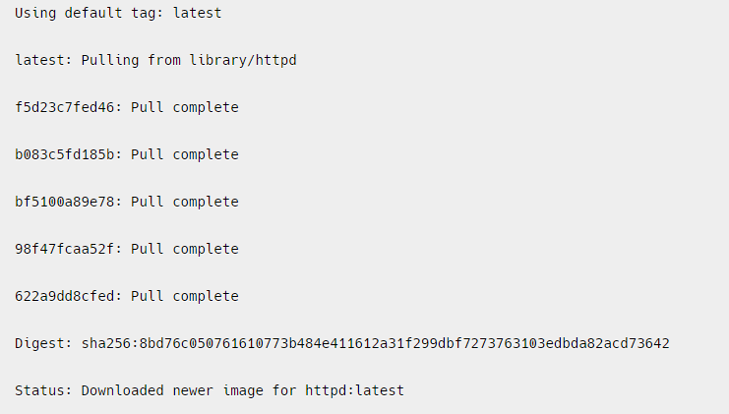
4 . Downloading Image
When we need to pull the docker image from dockerhub (docker repository) then ,the following example of pulling the the image and here we are taking Apache HTTP server image.
$ docker pull httpd

Slide 6
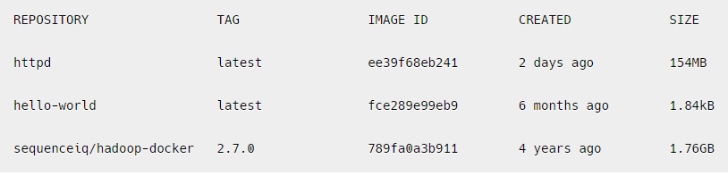
5. Images
To list all the docker images pulled on the system with image details such as TAG/IMAGE ID/SIZE etc.
$ docker images

Slide 7
6.RUN
The ‘docker run’ command is used to create and start a new container from a Docker image. The basic syntax of the ‘docker run’ command is as follows:
docker run [OPTIONS] IMAGE [COMMAND] [ARG…]
where,
OPTIONS: optional flags that configure the behaviour of the container, such as setting environment variables, mounting volumes, etc.
IMAGE: the name of the Docker image to be run.
COMMAND: the command to be executed when the container is started. If not provided, the default command specified in the Docker image will be used.
ARG: optional arguments passed to the command.
-d means

Slide 8
Options Available for executing Docker Run Command
Some commonly used options for executing the docker run command inside a container:
-it: Runs the container in interactive mode, allowing you to interact with the container through the command line.
-d: Runs the container in the background.
— name: Specifies a name for the container.
— rm: Automatically removes the container when it exits.
-p: Maps a host port to a container port.
-e: Sets an environment variable inside the container.
-v: Mounts a host volume inside the container.

Slide 9
1st Example : Running a Simple Image:
docker run httpd echo “Hello, World!”
This command runs a new container from the ‘httpd ’ image and executes the ‘echo’ command with the argument “Hello, World!”.

Slide 10
2nd example
Running a Container with a Specific Name:
$ docker run --name my-container httpd echo “Hello, World!”
--name : this option is to give the name of container
my-container: it is the name of container
Echo: it is the command
“hello,world!” – it is argument used
This command runs a new container with the specified name “my-container” from the httpd image and executes the echo command with the argument “Hello, World!”.

Slide 11
3rd Example : Setting Environment:
docker run -e MY_VAR=value httpd env
This command sets an environment variable ‘MY_VAR’ to the value “value” and runs a new container from the ‘httpd’ image.
The ‘env’ command is executed to display the list of environment variables in the container.

Slide 12

3rd Example in Detail
1. set the password with value pass@123 in busybox image
Command:
$ docker run –d –it –e PASSWORD=‘pass@123’ busybox sh

Slide 13
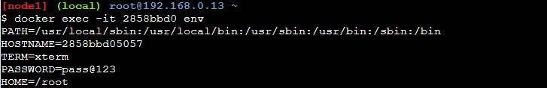
Then check the environment variable whether it is set or not
Command :
$ docker exec –it <container Id> env

Slide 14
2. To Set the NAMESPACE with value staging in ubuntu image:
Command is :

Slide 15
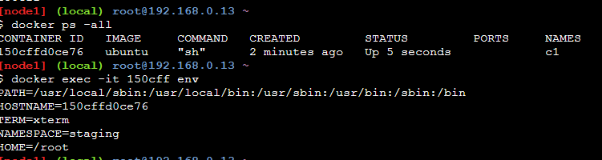
To check whether the given environment variable is set or not

Slide 16
2nd Method to set variables through env file
Step 1: Create one directory by mkdir
Mkdir <dir name>
Step 2: Create one file in that directory
cat > f1.env
NAMESPACE=‘mount’
PASSWORD=‘pass987’
Press ctrl c

Slide 17
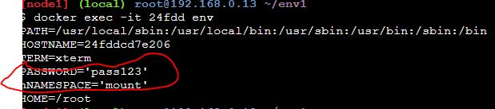
Step 3:

Slide 20
4th Example
$ docker run -it -d httpd
Here :
-it flag enables interactive mode, so you can interact with the container’s command line
The -d flag runs the container in the background and the httpd argument specifies the image name to use for the container. This command will pull the httpd image from Docker Hub if it is not already present on your local machine, create a container based on that image, and start it in the background.

Slide 21
7 What’s running?
To lists all the docker containers are running with container details.
.
$ docker ps

Slide 22
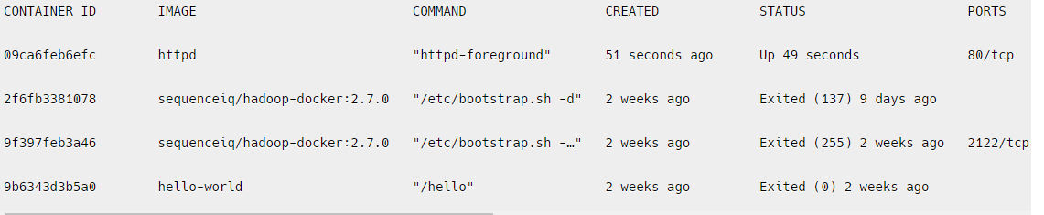
8. ps -a
To list all the docker containers running/exited/stopped with container details
$ docker ps -a

Slide 23
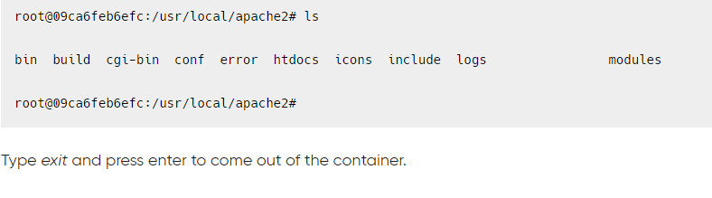
9. exec
Access the docker container and run commands inside the container in bash
$ docker exec -it 09ca6feb6efc bash
09ca6feb6efc --- it is Id of the container

Slide 24
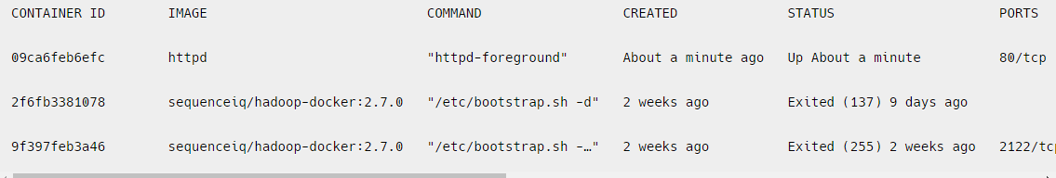
10. Removing container
Remove the docker container with container id mentioned in the command.
$ docker rm 9b6343d3b5a0
Run the below command to check if the container got removed or not.
$ docker ps -a

Slide 25
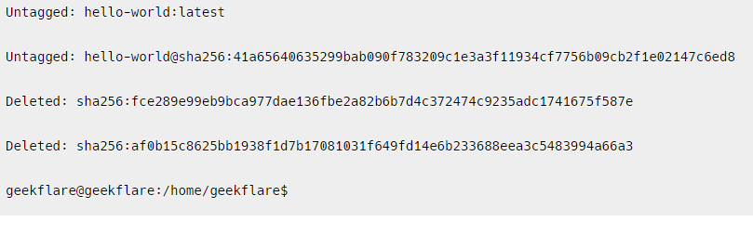
11. Removing image
Remove the docker image with the docker image id mentioned in the command
$ docker rmi fce289e99eb9

Slide 26
..contd..
To remove the image forcefully
$ docker rmi –f <image id>
docker rmi -f 92fa43a2ff60503fdf250
Untagged: httpd:latest
Untagged: httpd@sha256:7765977cf2063fec486b63ddea574faf8fbed285f2b17020fa7ef70a4926cdec
Deleted: sha256:92fa43a2ff60503fdf250ef0a16d4170aa2a47c4b5a60d427724283543a8792a

Slide 27
Practice Q#1
Run a Docker container named “DB-app" based on the “mongodb" image, and expose port 80 on the host to port 8082 on the container?

Slide 28
docker run -d -p 80:8082 --name DB-app mongo

Slide 29
Practice Questions
1. Explain how you would run an interactive container based on the "ubuntu" image, where you can execute commands within the container.
2. Filters the images by reference, where the tag is "latest."
3. To run a container named "temp-c1" based on the “ubuntu" image to execute a one-time command and then exit. How can you achieve this?
4. Filters the images by reference, where the reference starts with "webapp.“
5. You are managing a Docker registry with images for different environments, including development, staging, and production. You need to find all the images that are specifically tagged with "dev" for development. Write a Docker command to filter and list only those images.
Notes:
x

Slide 30
6. You have a Docker container running a web server and you want to access the web server from your host machine. How would you do it?
7. How would you set the environment variables for the database connection details and application mode with help of run command?

Slide 31
Solutions
1 docker run -it ubuntu /bin/bash
2. docker images --filter "reference=*:latest"
3. docker run --name temp-c1 ubuntu echo "Hello, world!“
4. docker images --filter "reference=webapp*"
5. docker images --filter "reference=*:dev"

Slide 33
Docker Commands for Images

Slide 34
List Docker Images
$ docker images
Or
2. $ docker image ls

Slide 35
Filtering Docker Image List
In order to filter the Docker image list results, you need to use the “docker images” command with the “–filter” followed by the filter in the form of a key-value tuple.
$ docker images --filter "<key>=<value>“
With the “–filter” option, you can specify the following keys :
“reference” : that can be used in order to isolate images having a certain name or tag;
“before” : to filter images created “before” a specific point in time;
“since” : to filter images since a specific point in time (usually another image creation);
“label” : if you used the LABEL instruction to create metadata for your image you can filter them later with this key
“dangling” : in order to isolate images that are not used anymore.

Slide 36
For Example you want to filter your image list given the name of your image.
$ docker images --filter "reference=deb*“
.

Slide 37
Similarly, if you are working with multiple images of the same repository, you can add an additional tag separated by a colon character
$ docker images --filter "reference=debian:8"

Slide 38
Filtering Unused Docker Images
Dangling” images are not images that are not used by any container anymore. We would define those images as “unused”, but not as “dangling”.
“Dangling” images are created whenever you create a new version of a Docker image with the same “image plus tag” pair.
In short, you would have the following output when listing your images
$ docker images -a
REPOSITORY TAG IMAGE ID CREATED SIZE debian 8 00cc44e1e1a2 3 days ago 129MB
<none> <none> 00b72214a37e 5 days ago 110MB
Those images or layers are not actively used anymore : they have been “re-tagged”.

Slide 39
To filter images that are defined as “dangling”, you can append the “dangling=true” option.
$ docker images --filter "dangling=true"
REPOSITORY TAG IMAGE ID CREATED SIZE
<none> <none> 00b72214a37e 5 days ago 110MB

Slide 40
Filtering Images on Date
When you want to list Docker images depending on their creation date or when they were downloaded for the first time.
If you are looking to list Docker images created before another image, you would run the following command.
$ docker images --filter "before=<image_name>“

Slide 41
In this case, the “Debian Jessie” image was the most recent one :
to list images created before, we would run the following command.
$ docker images --filter "before=debian:8"
REPOSITORY TAG IMAGE ID CREATED SIZE
debian latest 971452c94376 3 days ago 114MB
ubuntu latest 72300a873c2c 7 days ago 64.2MB

Slide 42
Also you can choose to list Docker images created after another image, you would use the “since” keyword instead of the “before” keyword.
$ docker images --filter "since=<image_name>"
$ docker images --filter "since=ubuntu"
REPOSITORY TAG IMAGE ID CREATED SIZE
debian 8 00b72214a37e 3 days ago 129MB
debian latest 971452c94376 3 days ago 114MB

Slide 43
Listing and Formatting Docker Images
Docker will by default display the results in a set of five different columns :
repository, tag, image ID, the creation date and the size of your image.
However, in some cases, you may want to have a different output if you need to process the information in a specific system
for example--→>
In order to list and format Docker images, you have to use the “docker images” command followed by the “–format” option and a Go template.

Slide 44
$ docker images --format <go_template>
Go template is a set of variables that are enclosed in double curly braces, representing the different columns to be displayed.
For example, if you want to have the output as the repository named followed by the image ID, you would run the following command.
$ docker images --format "{{.Repository}} has the following {{.ID}}"

Slide 45

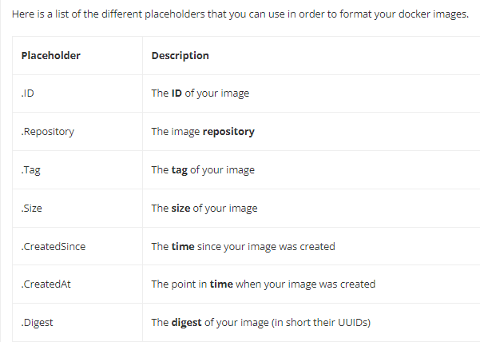

Slide 46
Listing Only Image IDs
In order to list only image IDs on Docker, you have to use the “docker images” command with the “–quiet” option to suppress all other columns.
$ docker images --quiet
$ docker images -q

Slide 47
Docker Exec Command With Examples

Slide 48
1.
The most popular usage of the “docker exec” command is to launch a Bash terminal within a container.
In order to start a Bash shell in a Docker container, execute the “docker exec” command with the “-it” option and specify the container ID as well as the path to the bash shell.
If the Bash is part of your PATH, you can simply type “bash” and have a Bash terminal in your container.
$ docker exec -it <container> /bin/bash

Slide 49
Docker Exec Interactive Option (IT)
If you are familiar with Linux operating systems, you have probably already heard about the concept of file descriptors.
Whenever you are executing a command, you are creating three file descriptors :
STDIN : also called the standard input that will be used in order to type and submit your commands (for example a keyboard, a terminal etc..);
STDOUT : called the standard output, this is where the process outputs will be written (the terminal itself, a file, a database etc..);
STDERR : called the standard error, it is very related to the standard output and is used in order to display errors.

Slide 50
So how are file descriptors related to the “docker exec“?
When running “docker exec” with the “-i” option, you are binding the standard input of your host to the standard input of the process you are running in the container.
In order to get the results from your command, you are also binding the standard output and the standard error to the ones from your host machine.

Slide 51
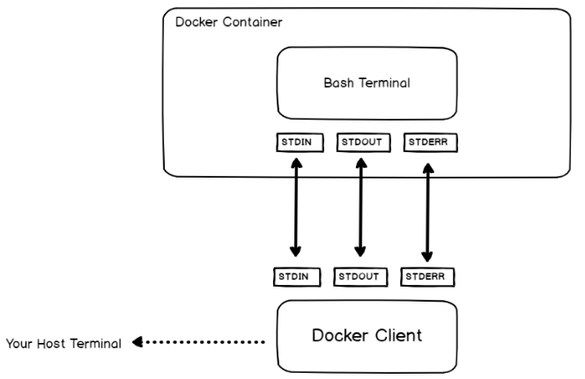

Slide 52
2. Docker Exec as Root
In some cases, you are interested in running commands in your container as the root user.
In order to execute a command as root on a container, use the “docker exec” command and specify the “-u” with a value of 0 for the root user.
$ docker exec -u 0 <container> <command>
For example, in order to make sure that we execute the command as root, let’s have a command that prints the user currently logged in the container.

Slide 53
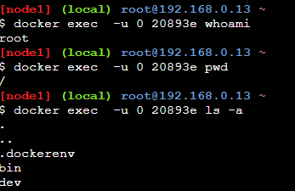

Slide 54
Docker Exec Multiple Commands
In order to execute multiple commands using the “docker exec” command, execute “docker exec” with the “bash” process and use the “-c” option to read the command as a string.
$ docker exec <container> bash -c "command1 ; command2 ;
command3“
Note : simple quotes may not work in your host terminal, you will have to use double quotes to execute multiple commands.
For example, let’s say that you want to change the current directory within the container and read a specific log file in your container.
.

Slide 55

To achieve that, you are going to execute two commands : “cd” to change directory and “cat” to read the file content

Slide 57
Executing a command in a specific directory
In some cases, the purpose of executing multiple commands is to navigate to a directory in order to execute a specific command in this directory.
You can use the method we have seen before, but Docker provides a special option for this.
In order to execute a command within a specific directory in your container, use “docker exec” with the “-w” and specify the working directory to execute the command.
$ docker exec -w /path/to/directory <container> <command>

Slide 58
$ docker exec -w /var/log 74f86665f0fd cat dmesg
Before this run a container

Slide 59
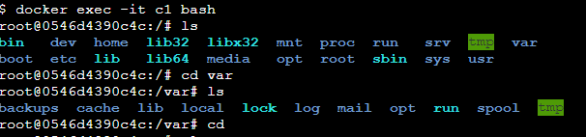

Slide 60
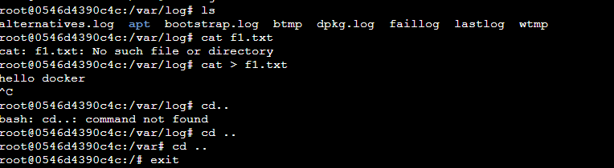

Slide 61


Slide 62
Docker Run vs Exec
Now that we have seen multiple ways of using the “docker exec” command, you may wonder what is the difference with the “docker run ” command.
The difference between “docker run” and “docker exec” is that “docker exec” executes a command on a running container.
On the other hand, “docker run” creates a temporary container, executes the command in it and stops the container when it is done.

Slide 63
For example, you can execute a Bash shell using the “docker run” command but your container will be stopped when exiting the Bash shell.
$ docker run -it ubuntu:18.04 bash
root@b8d2670657e3:/# exit
$ docker ps
(No containers.)
root@74f86665f0fd:/# exit

Slide 64
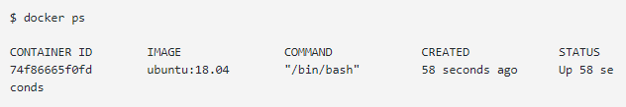
On the other hand, if a container is started, you can start a Bash shell in it and exit it without the container stopping at the same time.
$ docker ps
CONTAINER ID IMAGE COMMAND CREATED STATUS 74f86665f0fd ubuntu:18.04 "/bin/bash" 49 seconds ago Up 48 seconds
$ docker exec -it 74f86665f0fd bash

